Slide 1
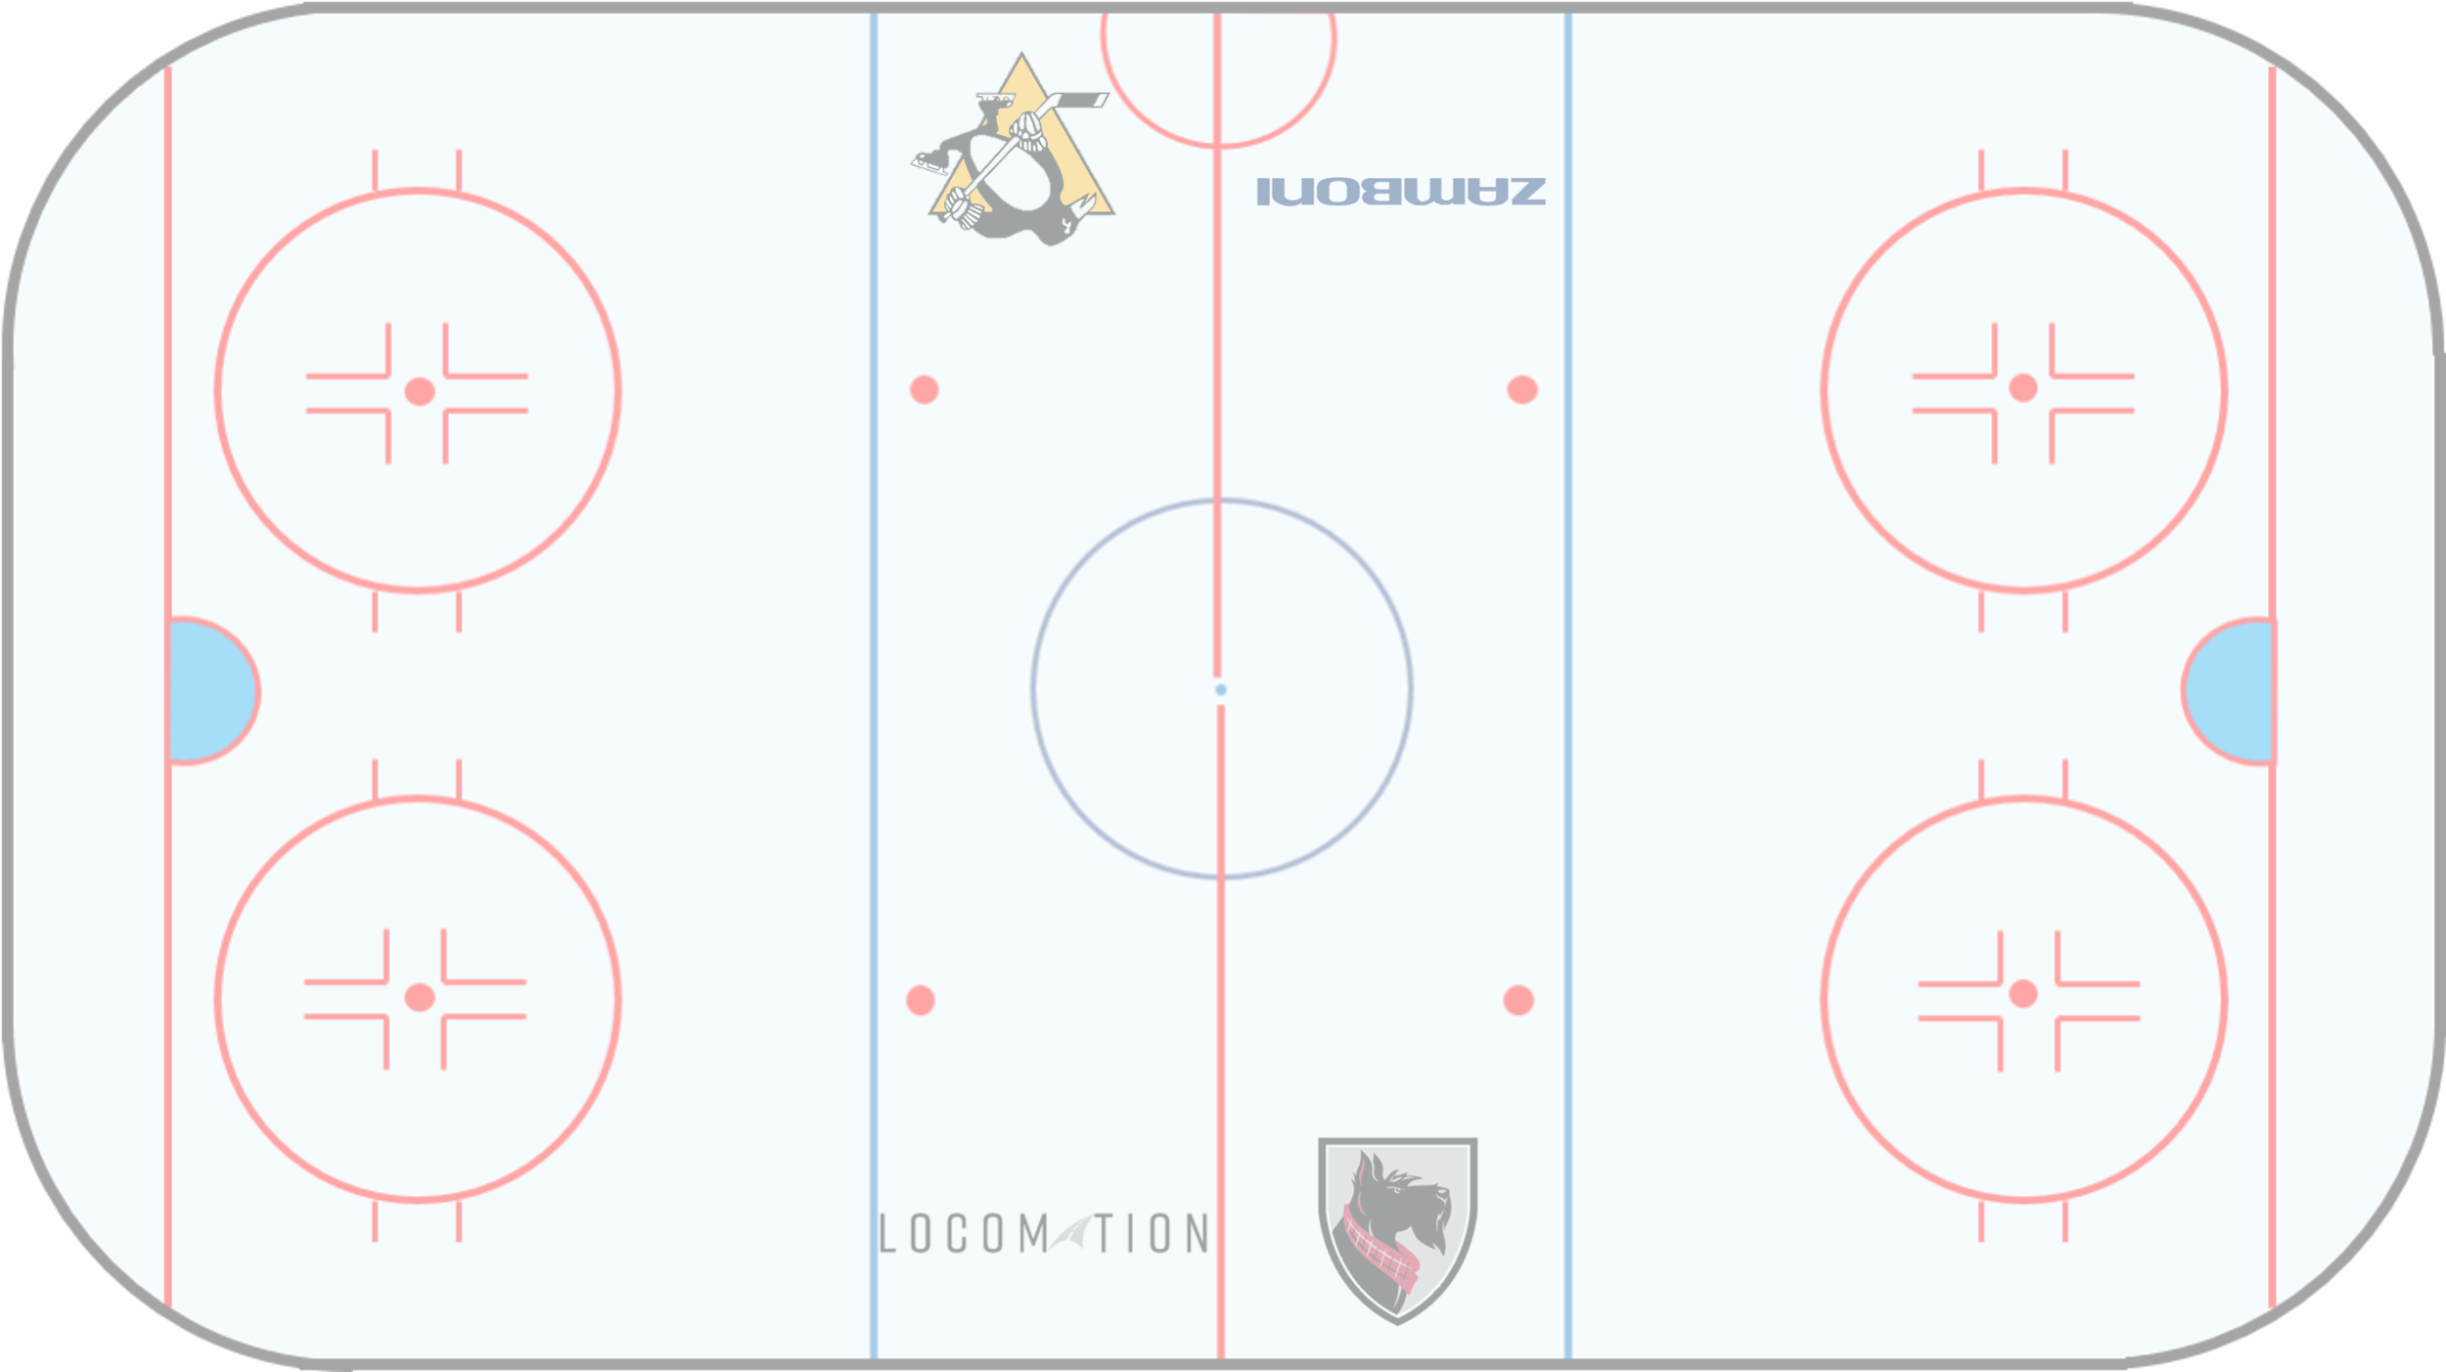

AIce
— Autonomous Zamboni Convoy
Standards & Regulations
Team-I: Rathin Shah, Nick Carcione,
Yilin Cai, Jiayi Qiu, Kelvin Shen
6 November, 2022

Slide 2


ISO 26262 Overview
ISO 26262 is a risk-based safety standard that’s derived from IEC 61508. It applies to electric and/or electronic systems in production vehicles. This includes driver assistance, propulsion, and vehicle dynamics control systems.
In other words:
ISO 26262
Absence of unreasonable risk due to hazards caused by malfunctioning
of E/E systems
Safety of new E/E and software functionality in vehicles;
• Trend of increasing complexity, software content, and mechatronics implementation;
• Risks from both systematic failure and random hardware failure.
ELECTRONICS CAN FAIL!! —---> ISO26262 provides evidence that these risks are minimized

Slide 3
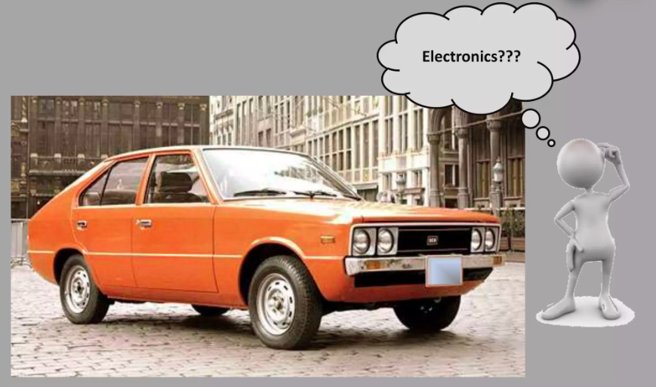
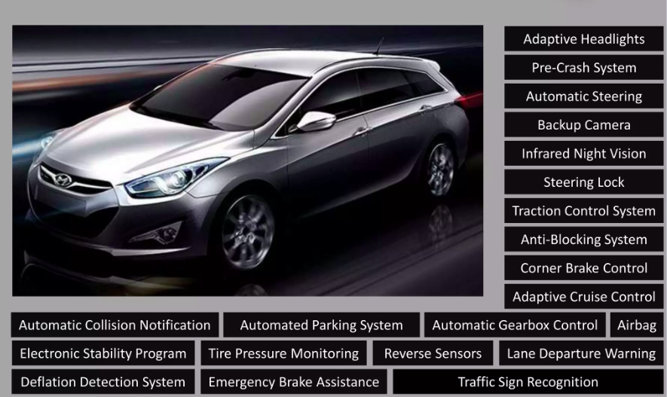
Why is it needed
Once Upon a Time… Now

Slide 4
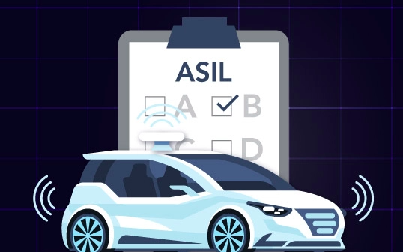
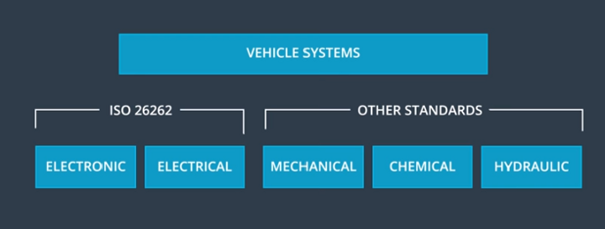
Who needs to do it - Market
ISO 26262, titled as “Road vehicles — functional safety”, is a functional safety standard used in the automotive industry,
Complying with this standard is critical for automotive product development
OEMs, their suppliers, and developers of automotive components all need to comply.

Slide 5
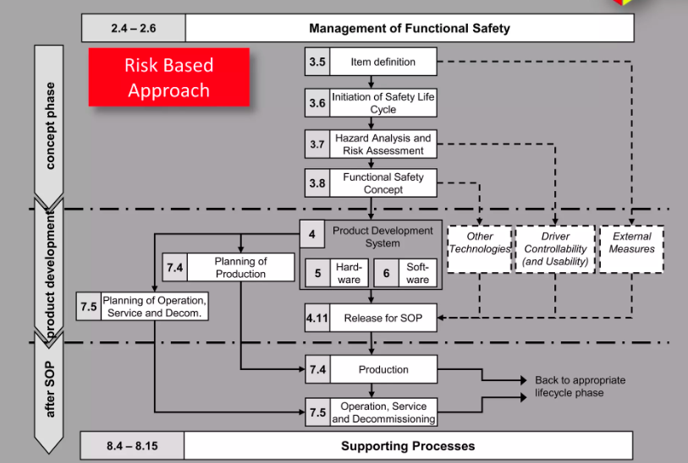
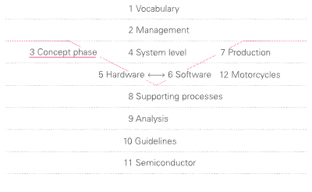
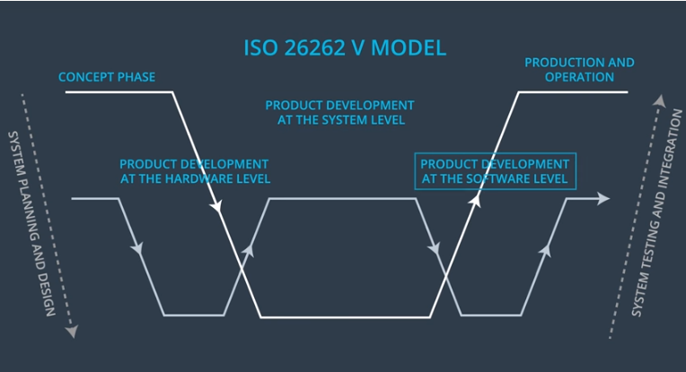
Structure of ISO 26262
Functional Safety for the beginning of the development or adaptation of an electronic product for vehicles –>Early phase of product development as the “concept phase”, and mainly describes it in part 3

Slide 6
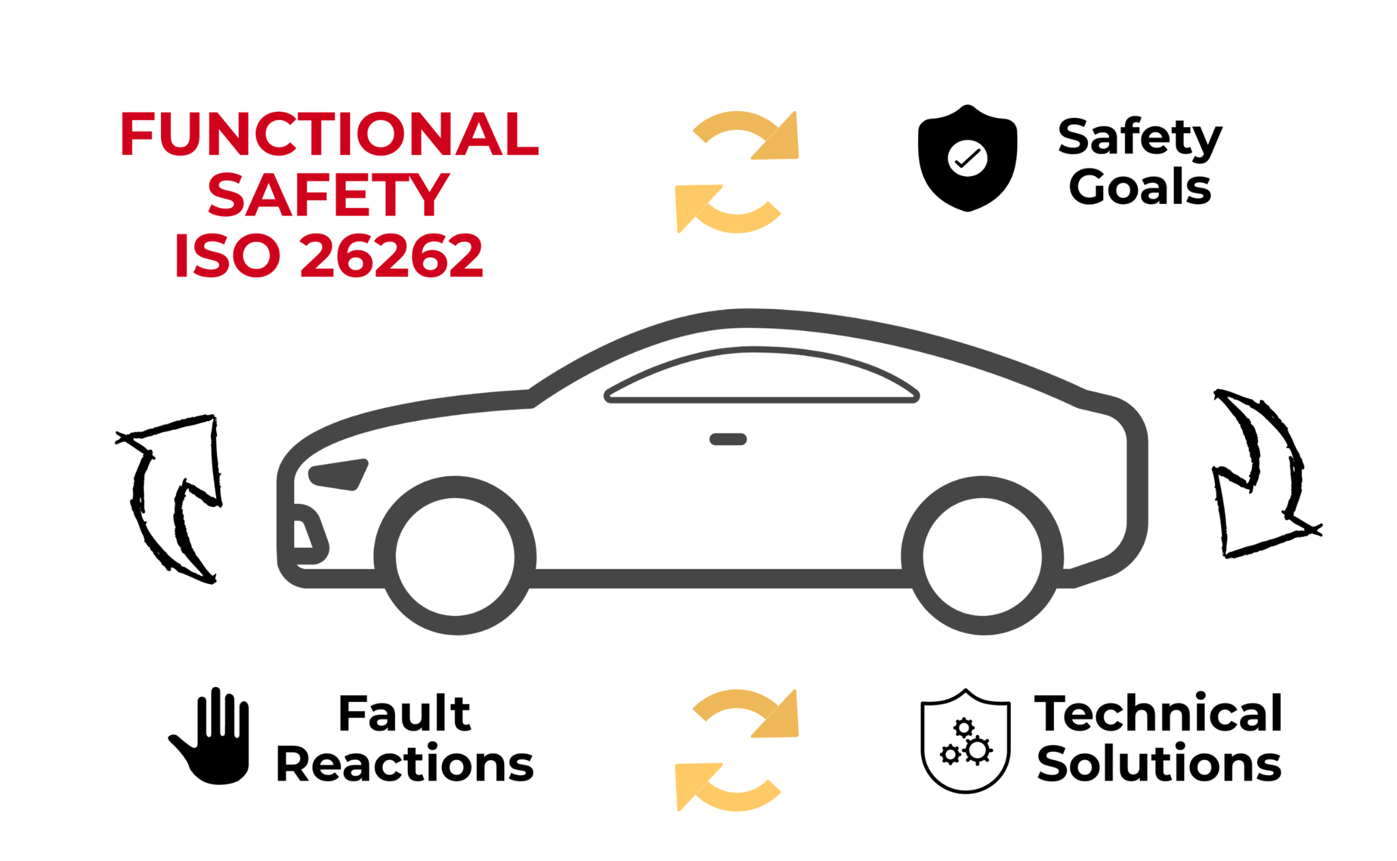

Concept Phase
Creates the right preparation for the actual product development.
Item definition —> denotes the subject of development, basically the product
Impact analysis at the item level —> Analysis if it is a new development or a modification of an existing item
Hazard analysis and risk assessment —> The item is subjected to a hazard analysis and risk assessment, in order to scale safety activities. Safety goals are formulated.
Functional safety concept —>The functional safety requirements are assigned to systems for implementation.A functional safety concept describes, in a comprehensive way, how the hazards should be mitigated.

Slide 7
Item Definition and Impact Analysis
Item Definition
The term “item” denotes the subject of development, your product.
One or more interacting electrical and/or electronic systems that implement the desired function
Includes functional requirements, interfaces, environmental conditions etc
Impact Analysis
Distinction is made whether it concerns either the new development or a modification of an existing item.
An impact analysis shows how the lifecycle should be adjusted, tailored, and which safety activities are necessary

Slide 8


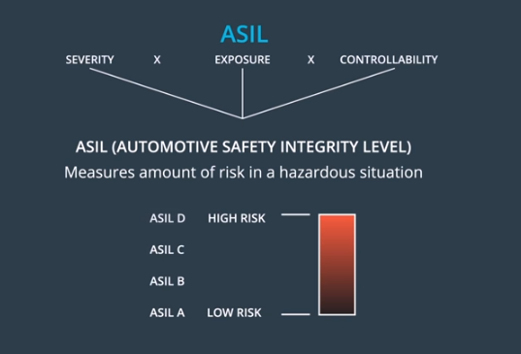
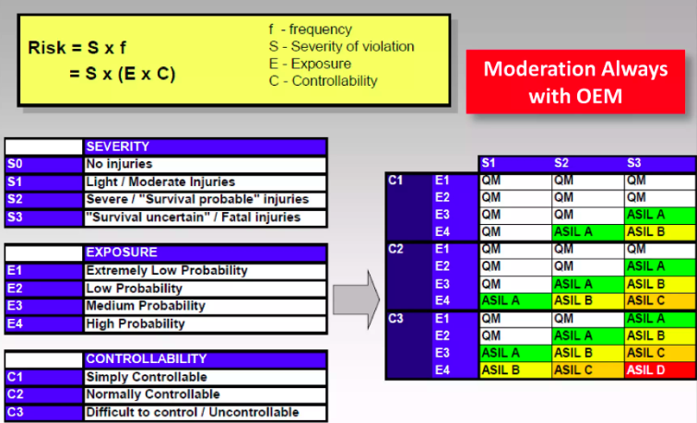
HARA - Essence of ISO 26262
Understanding the risks posed by the product.
The hazards that arise in the event of fault in our item are determined.
The “automotive safety integrity level”, or “ASIL”, is then determined for the relevant hazardous events.

Slide 9
Functional Safety concept
HARA —> Safety Goals
Safety goals are high-level safety requirements that are suitable for mitigating hazardous events
The Functional Safety Concept encompasses functional, implementation independent requirements on the safety of the Item.
It refines the Safety Goals by defining the Safety Goals attributes and it establishes a link between the functional safety requirements and the preliminary architecture.

Slide 10
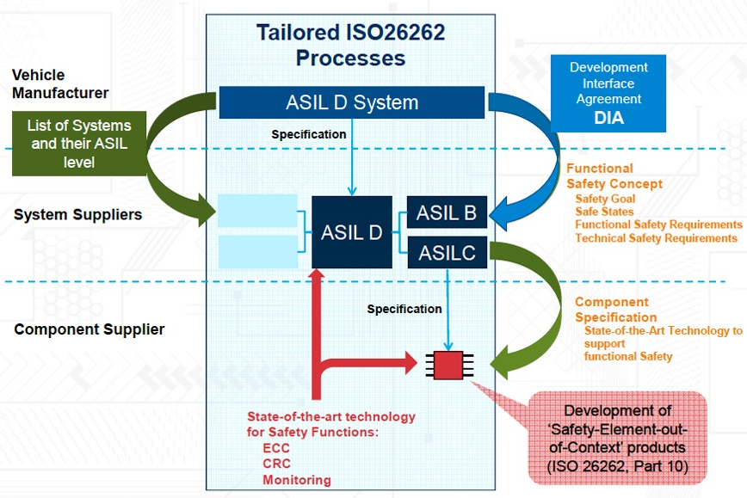
Main Prescriptions
No specific prescriptions but more of a guidelines on how to identify hazards and create functional safety requirements
Hazard Analysis and ASIL Level
Safety Analysis and Hazard Identification methods
Brainstorming, FMEA, DFA, HARA Trees,HAZOP method, etc
Determination of Safety Goal
Determination of Functional Safety Concept (FSC)
Hazard identification, where we analyze what goes wrong with the item under consideration.
Classification of the situation and hazard according to severity and probability of occurrence.
Calculating the ASIL.
Driving safety goals that identify what the system will do to lower risk.

Slide 11
ISO 26262 for AIce
Item Definition:
Drive by wire and autonomy sensors equipped electric motor driven ice resurfacer
HARA and FSC
Item | Malfunction | Risk Scenario | Hazard | Safety Goal | Safety Requirement | ASIL
Throttle by Wire | Accelerates more than intended | Following leader Obstacles in rink | Collision possible with Leader or Infrastructure and People in rink | Avoid unintended acceleration | System should have acceleration bounds | D
Brake by Wire | Brakes more than intended | Vehicle skids on ice surface | Collision with people or infrastructure due to loss on vehicle control | Avoid Panic and High force braking | System should have bound on rate of pedal travel | D
Steer by Wire | Unintended Vehicle Lateral Motion/Unintended Yaw | The vehicle moves laterally more than, at a faster rate than, or in the opposite direction of what is commanded by the driver or another vehicle system controller. | Collision with Leader/people/infrastructure | The SbW system is to prevent unintended self-steering in any direction under all vehicle operating conditions. | System should have feedback to check current and commanded steering | D

Slide 12
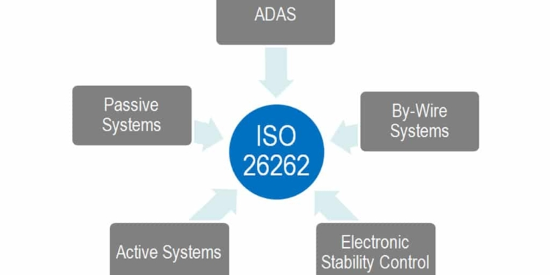
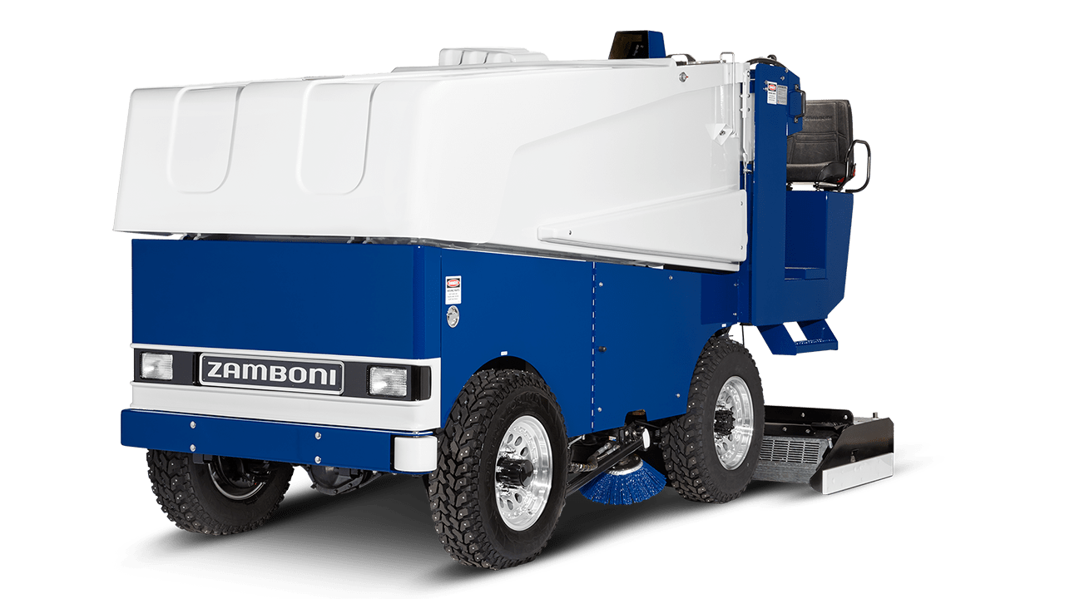
ISO 26262 for AIce
Item | Malfunction | Risk Scenario | Hazard | Safety Goal | Safety Requirement | ASIL
Perception and sensing | Decision making has latency | Vehicle cannot make decision in time so that follower will lose track of the leader | Sensor latency is too high and vehicle cannot response in real time | Avoid control latency and avoid latency in response | System should sensor data streaming test | D
Trajectory planning | Make wrong trajectory planning | Follower turns blind and cannot make right decision so that it will lose track of the leader | Sensor feedback gets cut or lose signal | Make sure that the follower can always have information of the environment and will not turn blind | System cannot make wrong decision | D

Slide 13
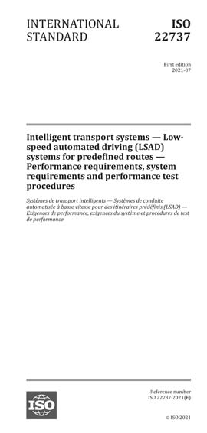
ISO 22737 Overview
Published July 2021
The first international safety standard for L4 systems
Main focus is low-speed automated driving (LSAD) systems on predefined routes
Specifies
Requirements for operational design domain (ODD)
System requirements
Minimum performance requirements
Performance test procedures

Slide 14
Important Vocabulary
Low-speed automated driving (LSAD) system:
L4 system that operates at ≤ 8.89 m/s (32 km/h, 20 mph)
Predefined route:
Trajectory defined before trip starts from point of origin to destination(s)
Operational design domain (ODD):
Operating conditions specified by the manufacturer
Hazardous situation:
Condition that can result in an imminent collision with an obstacle
Minimal risk manoeuvre (MRM):
Action triggered and executed by LSAD to achieve minimal risk condition

Slide 15
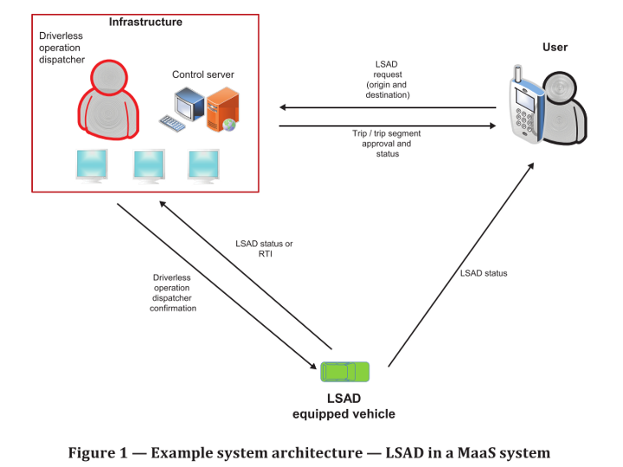
Use Case
Last-mile transportation
Transport in commercial areas, business or university campus areas and other low-speed environments

Slide 16

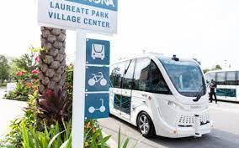
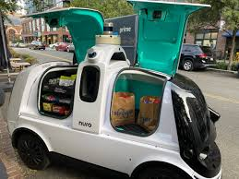
Intended Markets/Products
Any low-speed L4 vehicle that operates along predefined routes:
Robotaxis
Waymo, Cruise
Autonomous shuttles
Zoox, Beep
Autonomous delivery robots
Nuro
Other applications
Logistics (Outrider)
*Also extends to any dual-mode vehicles

Slide 17
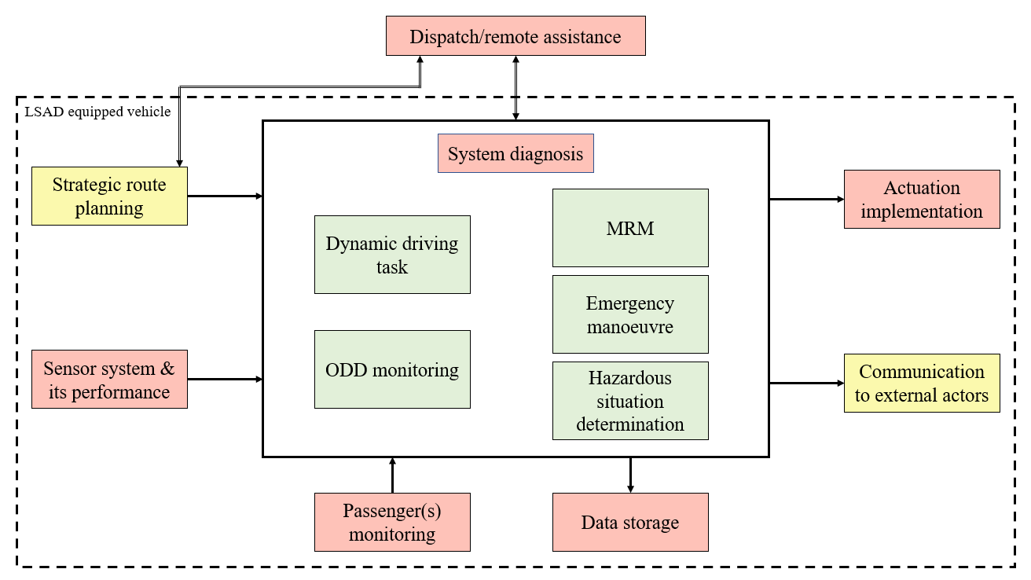
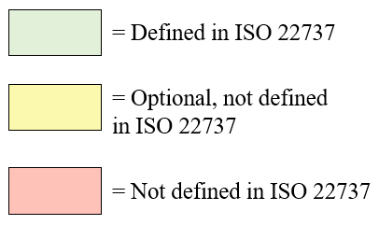
LSAD System Architecture

Slide 18
Main Prescriptions – Basic Requirements
Operating Capabilities:
Follow a predefined route
Detect a hazardous situation
Brake/steer to avoid/mitigate collisions with obstacles
Perform MRM
Inform dispatcher of fault state
Provide warnings to road users in case of a hazardous situation
ODD Attributes:
Low-speed
Area(s) of application
Predefined routes
Lighting conditions
Weather conditions
Road conditions
Presence/absence of VRUs
Presence of static obstacles
Connectivity requirements

Slide 19
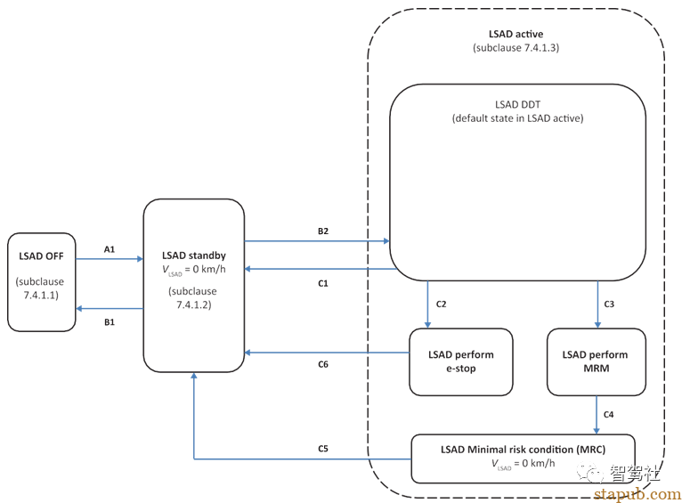
Main Prescriptions – Basic Requirements
A1: power on, self-test passed
B1: system failure OR power turned
B2: ODD met, ADS engaged, data recording available + engaged
C1: disengage command
C2: e-stop pressed
C3: some anomaly or system loss, safe to proceed not confirmed
C4: at standstill
C5: confirmation to proceed to standby state
C6: C4 + C5

Slide 20
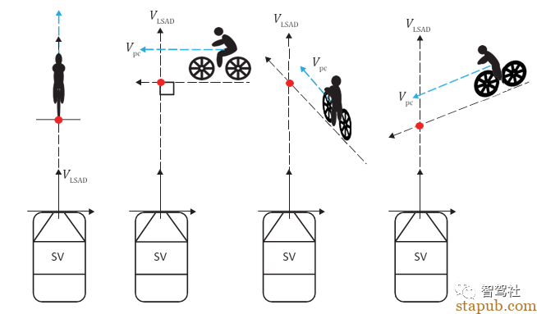
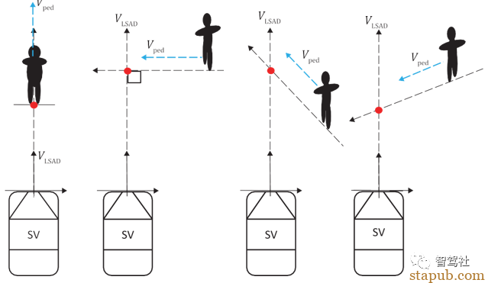
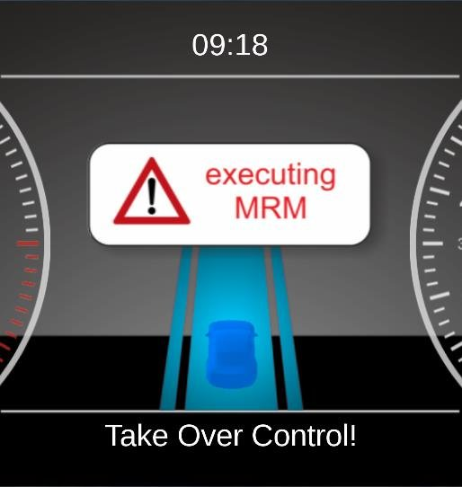
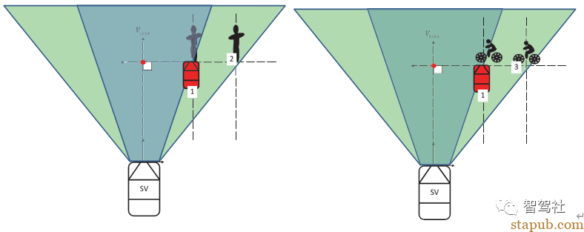
Main Prescriptions – Functional Requirements
Hazardous Situation Determination
Non-occluded view
Occluded view
Minimal Risk Manoeuvre (MRM)
E-Stop
Non-occluded example case
Occluded example case

Slide 21
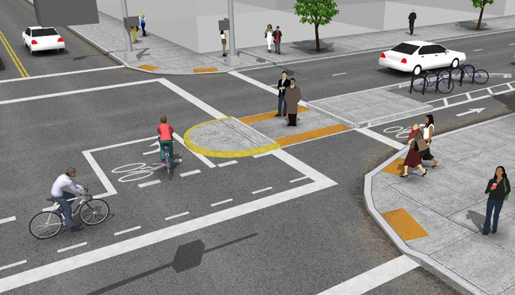
Main Prescriptions – Performance Requirements
Maximum ego-vehicle speed
Object detection requirements
Vulnerable Road User (VRU) as an obstacle, e.g. pedestrian, cyclist, etc.
Deceleration

Slide 22
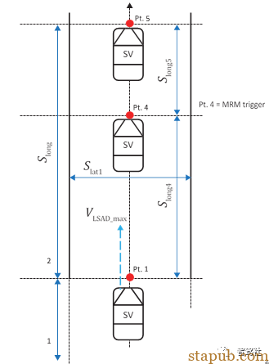
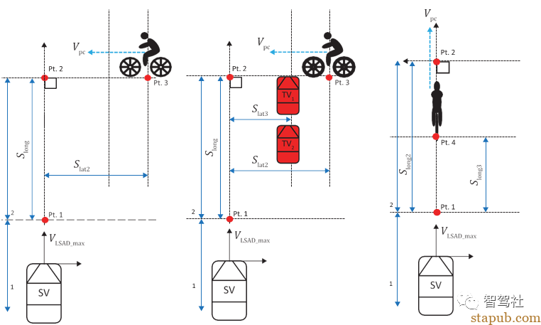
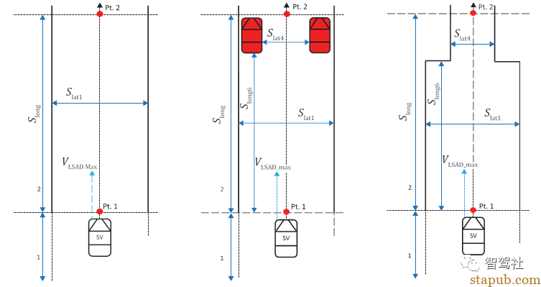
Main Prescriptions – Performance Test Procedures
Hazardous situations test
VRU as an obstacle
Turning around a corner
False positive
Drivable Area test
Minimal Risk Manoeuvre (MRM) test
Hazardous situation test example
Drivable area test example
MRM test example

Slide 23
ISO 22737 for AIce
Emergencies may occur during system operation, such as unintended behavior of the vehicle, vehicle incapacity, etc
Request an E-stop
The E-stop interface should be visible, easy to understand, and accessible to users
In E-stop mode, the system shall perform emergency deceleration to bring the vehicle to a standstill
People on the ice rink during ice resurfacing
Require obstacle detection
Require collision avoidance
Provide warnings to road users
Leader-follower autonomy stack testing
The test procedure should be repeated (>=5)

